Slide 1

Module 4
Mgmt 6062 - Project Risk and Quality
There are slide notes in this PowerPoint, make sure your notes pane is visible below the slide pane

Slide 2
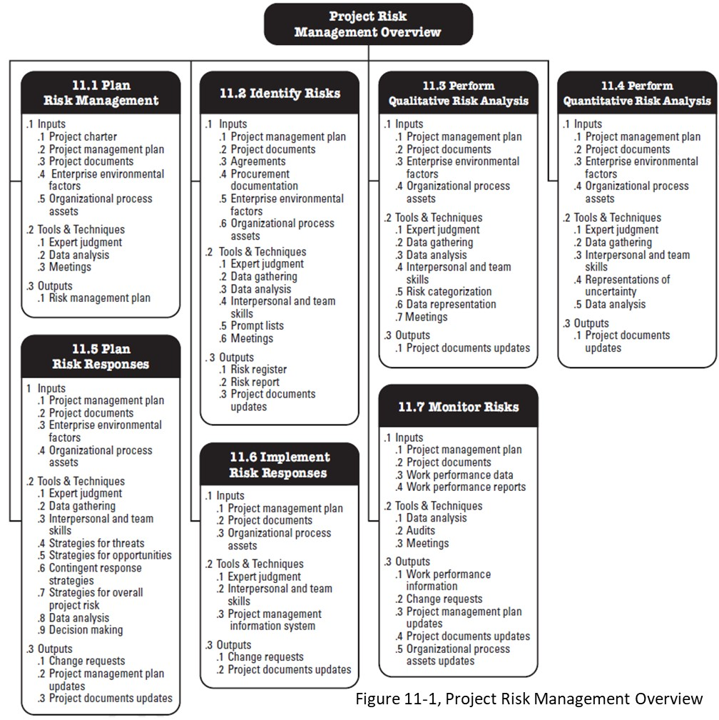
Module agenda
Qualitative
Risk Analysis

Slide 3


Risk management process
11.1 Plan Risk Mgt
Develop Risk Register
11.3 Qualitative Risk Analysis
11.4 Quantitative Risk Analysis
11.5 Plan Risk Responses
11.6 Implement Risk Responses
11.7 Monitor Risks
11.2 Identify Risks
Updates?
Updates?
IMPORTANT: Iterative process throughout the entire project life cycle

Slide 4
Qualitative risk analysis
Objectives of Perform Risk Qualitative Risk Analysis Process
Subjectively evaluate the probability and impact of each risk
Create a shorter list of risks by determining the critical risks you will quantify further and/or create a risk response
Make a decision as to whether to proceed with project (no-go/go decision) – in other words, the risk assessment may show that the project should not be taken on

Slide 5

Before you begin qualitative analysis…..
Before you begin:
Determine additional information needed (go back to charter; ask experts; review data available)
Determine frequency and timing of risk
Assumptions testing (rank stability: 1 to 10)
Data quality assessment (is the data/info good enough to make qualitative evaluations? able to rank 1 to 10?)

Slide 6
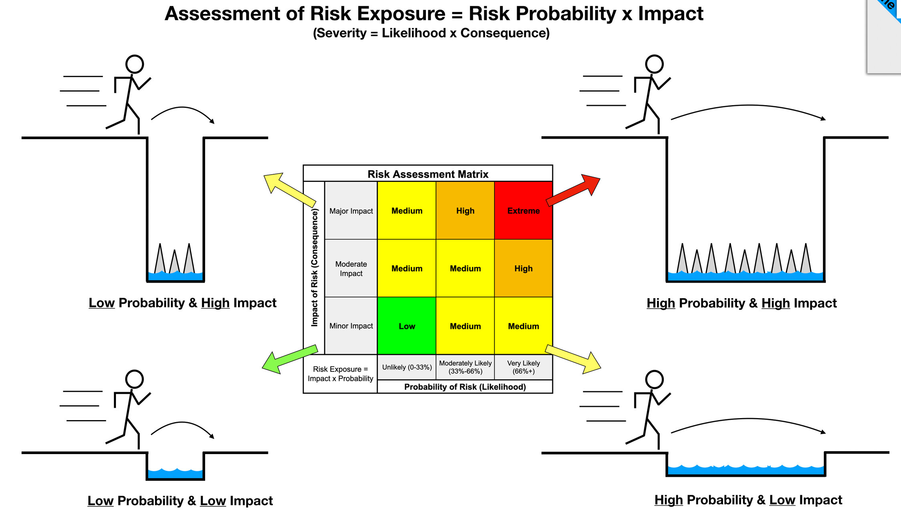
Probability and impact
Probability is the likelihood that a risk will occur
Impact is the effect the risk will have on the project IF it occurs
Handout
Notes:
Image https://www.theprojectmanagementblueprint.com/blog/risk-management/risk-exposure-equals-probability-times-impact

Slide 7
Probability scale for rating systems
During qualitative risk analysis, the probability rating will be subjective.
Use a single probability scale to be consistent.
The rating scale should be defined.
Notes:
*City evaluation scale

Slide 8
Why scale definition/understanding is important
Everyone contributing to the process need to be using the same “language”
An example of use of rating scale for contractor evaluation….where it can go wrong:
My understanding:
1 | 2 | 3 | 4 | 5 | 6 | 7 | 8 | 9 | 10
10=Excellent
My client’s approach:
1 | 2 | 3 | 4 | 5 | 6 | 7 | 8 | 9 | 10
9=Excellent
10=Beyond expectations

Slide 9
impact scale for rating systems
During qualitative risk analysis, the impact rating will be subjective.
Use a single impact scale to be consistent.
The rating scale should be defined (make “fine” enough).

Slide 10
How to determine probability and impact
Option 1: Ask five people familiar with the project and/or risk and ask them for their probability and impact rating. Discard the highest and lowest and average the three values remaining.
Option 2: Have all risks entered into a spreadsheet and have each person working on the project (within reason) provide their assessment of impact and probability. Total the probabilities and impact for each risk and calculate the mean.

Slide 11
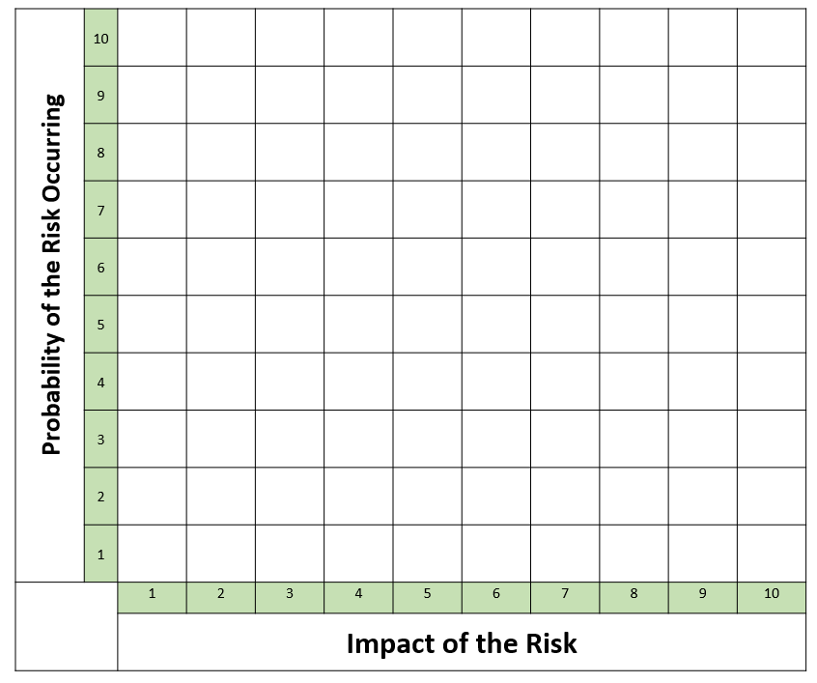
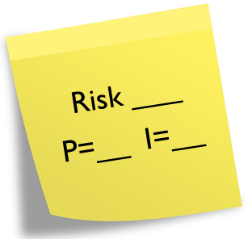
How to determine probability and impact
Option 3:
Create a large chart on white board or paper.
Individuals or small groups agree on location of risks in appropriate place on chart. Each sticky note is marked with the probability and impact determined. They place the notes on the chart.
As a group:
Discuss the risks marked and make adjustments.
Determine if any risks need additional information and eliminate risks that are no longer considered valid risks.

Slide 12

Let’s use option 3 for the Kilimanjaro expedition
Using post-it notes, or slips of paper, and place each threat and opportunity on a paper grid, based on your assessment of probability and impact. Alternatively you can use the Simple Probability Impact Matrix.xlsx found in FOL.
But…first….how are you defining probability and impact scales?
When all notes are in place, review each risk to determine if adjustments are required.
Risk ___
P=__ I=__

Slide 13
Kilimanjaro - Defining impact and probability

Slide 14
Risk (T): Wild animal attack
https://www.true.travel/what-animals-live-on-kilimanjaro/

Slide 15
Risk (T): Loss of satellite communication

Slide 16
Update the risk register for the Kilimanjaro expedition
Risks should already be identified and entered in cause-risk-effect format into the Risk Register.xls found in FOL (previous module).
Add qualitative probability and impact ratings.

Slide 17
risk ranking within a project
Not all risks move forward from qualitative to quantitative analysis.
Calculate risk score for each activity (multiply probability times impact)
Rank the risks based on risk score.
Risks move forward (for quantitative analysis) if:
Option 1: Any risks with a risk score of certain number (determined in your risk management plan) move forward. If more or less risk adverse, use a lower or higher risk score.

Slide 18
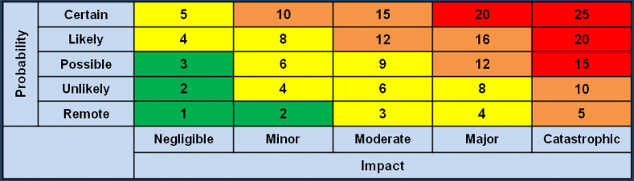
risk ranking within a project
…continued….
Risks move forward (for quantitative analysis) if:
Option 2: Create a probability and impact matrix for all projects in your organization. Risks within a predetermined range move forward, those in middle area may move forward or are just documented. For examples, see the figure at the top of the page (ignore the lower figure at): http://www.systemico.ca/quality-and-risk-management/enterprise-risk-management-erm/risk-assessment/
Option 3: Use PMBOK, Probability and Impact Matrix (next slide)

Slide 19
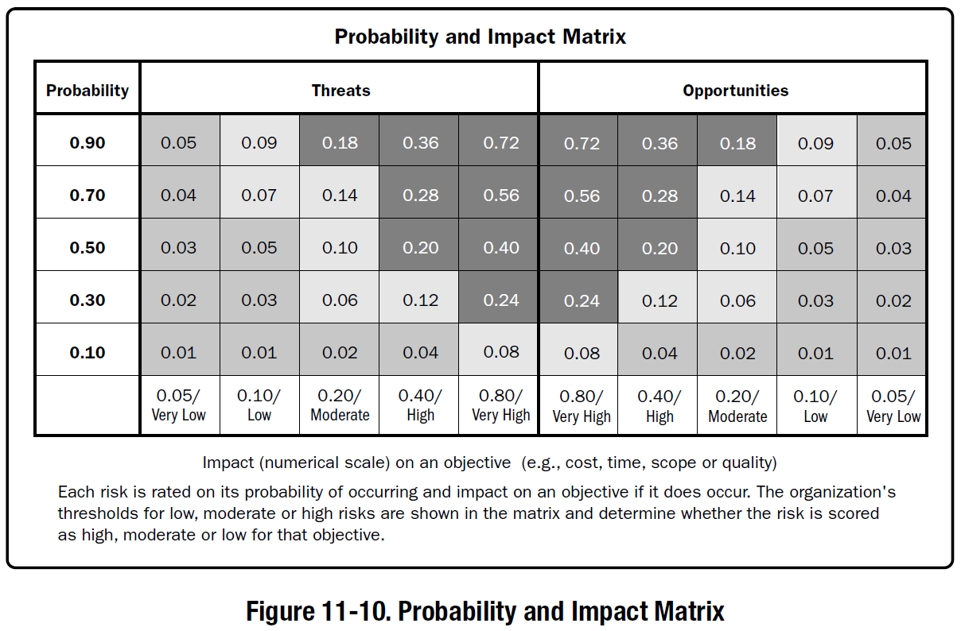
Pmbok: probability and impact matrix
Probability and Impact, Qualitative vs Quantitative

Slide 20
Project risk score and risk threshold
Project Risk Score
Add the risk score for the individual risks on the project and then divide that sum by the number of risks. Consider only “significant” risks.
The risk score for the project should be lower after risk response planning.
Project Risk Threshold
The total amount of risk acceptable on the project and usually takes the form of maximum project risk score.
Who sets risk threshold?
Both values help to make Go/No-Go decisions

Slide 21
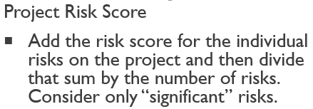
Risk ranking
Risk Name | Probability (1-10) | Impact (1-10) | Risk Score (P x I) | Risk Ranking within the Project?
A | 8 | 7
B | 6 | 5
C | 5 | 8
D | 3 | 4
E | 5 | 1
F | 6 | 7
G | 4 | 8
H | 7 | 7
I | 3 | 9
J | 4 | 6
Total risk score for the project, considering significant risks only = total of individual risk scores divided by number of risks. Assume significant risks have score =>25. |  |  | What is overall project risk score?

Slide 22
Risk ranking
Risk Name | Probability (1-10) | Impact (1-10) | Risk Score (P x I) | Risk Ranking within the Project?
A | 8 | 7 | 56 | 1
B | 6 | 5 | 30 | 6
C | 5 | 8 | 40 | 4
D | 3 | 4 | 12 | -
E | 5 | 1 | 5 | -
F | 6 | 7 | 42 | 3
G | 4 | 8 | 32 | 5
H | 7 | 7 | 49 | 2
I | 3 | 9 | 27 | 7
J | 4 | 6 | 24 | -
Total risk score for the project, considering significant risks only = total of individual risk scores divided by number of risks (assume significant risks have score =>25) |  |  | Total = 276 276/7=39.4
Notes:
There are 3 numbers that have been “stroked out”, reduce the number of risks from 10 to 7.

Slide 23
Risk ranking
Risk Name | Probability (1-10) | Impact (1-10) | Risk Score (P x I) | Risk Ranking within the Project?
A | 8 | 7 | 56 | 1
B | 6 | 5 | 30 | 6
C | 5 | 8 | 40 | 4
D | 3 | 4 | 12 | -
E | 5 | 1 | 5 | -
F | 6 | 7 | 42 | 3
G | 4 | 8 | 32 | 5
H | 7 | 7 | 49 | 2
I | 3 | 9 | 27 | 7
J | 4 | 6 | 24 | -
Total risk score for the project, considering significant risks only = total of individual risk scores divided by number of risks (assume significant risks have score =>25) |  |  | Total = 276 276/7=39.4
What if project risk threshold is 35?

Slide 24
Risk ranking between projects
The risk ranking of a project is based on its risk score as compared to risk scores of other projects.
Can help to decide which projects to take on and where it fits as far as risk with other projects.
The project with the highest risk ranking should have the best project manager.

Slide 25
tips
Carry forward activities for further analysis that have a lot of risks.
Move forward common causes of risk.
Highlight risky activities on the network diagram or Gantt chart by highlighting them in another colour (or other way).
Note activity risk score and person assigned on Gantt chart.
…..in other words, incorporate risk analysis into other aspects of project management.

Slide 26
What’s next after qualitative analysis?
Proceed to the Perform Quantitative Risk Analysis process if:
You have identified all project risks
It is worth the time and money to address the risk
It is a high-priority / high-impact project
Little tolerance for cost or schedule overruns
Pause. Does it make sense? Remember: Garbage in, garbage out.

Slide 27
Summary of perform qualitative risk analysis process
Collect additional information.
Determine if you will use risk owners now to help qualify risks.
Test any assumptions.
Determine what scales to use for probability and impact and how they will be used.
Determine probability, impact, rankings, limits and timing for each risk.
Determine which risks move forward.
Determine overall risk score and ranking for the project.
Document the risks.
Look for trends.
Make a go / no go decision about project.
Move on to Quantitative Analysis (or Plan Risk Responses).

Slide 28

Estimated Monetary Value (EMV) My bulldozer Broke down!
You own a construction company
You have only one bulldozer
If it breaks down, you can probably fix it yourself but you need to rent another while your equipment is repaired, it costs $2000 per day to rent a bulldozer.
Based on previous projects and the age of your bulldozer, there is a 10% chance it will break down. Repairs would take two days.
What is the EMV of a potential bulldozer breakdown considering only the rental cost?
There could be other costs or impacts.
An EMV event that costs money or delays a project is considered negative (-). This is the reverse of what we use in our Risk Register.
EMV = 0.10 x -$2000 x 2 days = -$400 or negative $400
What do you do with that EMV as you plan your project?

Slide 29
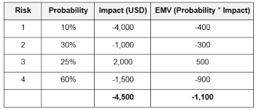
Expected monetary value (EMV) of risks
Expected Monetary Value is the probability-weighted average of all possible outcomes, calculated by summing all the quantitative probabilities times impacts for risk on a project.
Threats are negative and opportunities are positive in EMV. Therefore, risk 3 is actually an opportunity (not a threat).
EMV = ∑ (P x I)
Opportunity

Slide 30
Emv exercise
Handout
You are planning the design of new software. Your project estimate results in a net project cost of CAD $800,000 and schedule of 448 days. In addition, your analysis has come up with the following (keep in mind that the real world will probably have many more risks than the five listed here):
There is a 10 percent probability of a stakeholder making a major change to the project, costing the project $150,000 and a 28 day delay.
There is a 30% probability of gaining a new, valuable resource, making the project $60,000 cheaper and saving 56 days.
There is a 70% probability that the software will be delayed in its release from the vendor, resulting in an extra $6,000 labour expense and a 40-day delay.
There is a 10% probability that the coding may be simpler than expected, resulting in a $5,000 savings and a savings of 14 days.
There is a 10% probability of a major bug causing $16,000 of rework and a 42 day delay.
What is the expected monetary value of the cost and time of these risks?

Slide 31
EMV exercise
Handout
Risk | Calculation | Expected Monetary Value of the Cost
A
B
C
D
E
 |  | Total
Risk | Calculation | Expected Monetary Value of the Time
A
B
C
D
E
 |  | Total

Slide 32
EMV exercise – EMV for risks in a project
Risk | Calculation | Risk Type | EMV of the Cost
A | -0.10 x $150,000 | Threat | -$15,000
B | 0.30 x $60,000 | Opportunity | $18,000
C | -0.70 x $6,000 | Threat | -$4,200
D | 0.10 x $5,000 | Opportunity | $500
E | -0.10 x $16,000 | Threat | -$1,600
 |  |  | Total -$2,300

Slide 33
EMV exercise – EMV for risks in a project
Risk | Calculation | Risk Type | EMV of the Cost
A | -0.10 x $150,000 | Threat | -$15,000
B | 0.30 x $60,000 | Opportunity | $18,000
C | -0.70 x $6,000 | Threat | -$4,200
D | 0.10 x $5,000 | Opportunity | $500
E | -0.10 x $16,000 | Threat | -$1,600
 |  |  | Total -$2,300
Risk | Calculation | Risk Type | EMV of the Time
A | -0.10 x 28d | Threat | -2.8 d
B | 0.30 x 56d | Opportunity | 16.8 d
C | -0.70 x 40d | Threat | -28 d
D | 0.10 x 14d | Opportunity | 1.4 d
E | -0.10 x 42d | Threat | -4.2 d
 |  |  | Total -16.8 days

Slide 34
EMV exercise
Handout
Assuming that these five risks are the only risks on the project:
What is the best case (only good things happen, opportunities)?
With no further analysis (without a risk analysis), how much will management expect the project to cost and it’s duration?
What is the expected monetary value of the project?
What is the worst case (only bad things happen, threats)?
Note, although our risk analysis EMV could be negative because we only have threats (which are going to cost us more money), we would flip the EMV to a positive number when we add it to our estimated project budget. We need a larger budget to deal with the threats, if we add a negative number we would end up reducing our budget.

Slide 35
EMV exercise
Handout
You are planning the design of new software. Your project estimate results in a Work Package estimate of CAD $800,000 and schedule of 448 days. What would be your estimates?
 | Question | Answer for Cost
a | Best case
b | Estimate excluding risks
c | Expected monetary value
d | Worst case
 | Question | Answer for Time
a | Best case
b | Estimate excluding risks
c | Expected monetary value
d | Worst case

Slide 36
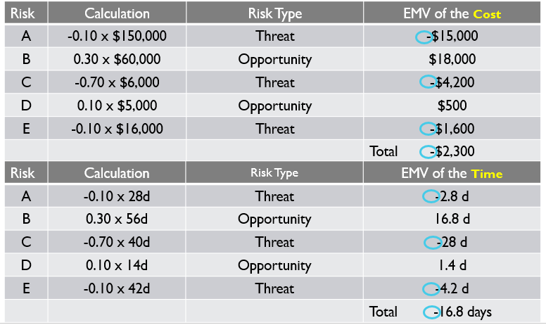
EMV exercise
You are planning the design of new software app. Your project estimate results in a Work Package estimate of CAD $800,000 and schedule of 448 days. What would be your Best Case estimate?
 | Question | Answer for Cost
a | Best case | 800,000-60,000-5,000=$735,000
b | Management expects | $800,000
c | Expected monetary value | 800,000+2,300=$802,300
d | Worst case | 800,000+150,000+6,000+16,000=$972,000
 | Question | Answer for Time
a | Best case | 448-56-14=378d
b | Management expects | 448d
c | Expected monetary value | 448+16.8=464.8d
d | Worst case | 448+28+40+42=558d

Slide 37
EMV exercise
You are planning the design of new software app. Your project estimate results in a Work Package estimate of CAD $800,000 and schedule of 448 days. What would be your estimates?
 | Question | Answer for Cost
a | Best case | 800,000-60,000-5,000=$735,000
b | Estimate excluding risks | $800,000
c | Expected monetary value | 800,000+2,300=$802,300
d | Worst case | 800,000+150,000+6,000+16,000=$972,000
 | Question | Answer for Time
a | Best case | 448-56-14=378d
b | Estimate excluding risks | 448d
c | Expected monetary value | 448+16.8=464.8d
d | Worst case | 448+28+40+42=558d

Slide 38
EMV exercise
You are planning the design of new software app. Your project estimate results in a net project cost of CAD $800,000 and schedule of 448 days.
Interpretation:
Without analyzing risks, a person could say that the project budget should be $800,000 and take 448 days.
Taking the uncertainties into account the project cost could range from $735,000 and 378 days to $972,000 and 558 days.
If no further risk management actions are taken to decrease threats or increase opportunities the project could be re-estimated to cost $802,300 and take 465 days.
If $972,000 and 558 days are beyond the risk tolerances, the Plan Risk Responses process should be done to reduce or eliminate some threats impacting costs and time.
 | Question | Answer for Cost
a | Best case | $735,000
b | Estimate excluding risks | $800,000
c | EMV | $802,3000
d | Worst case | $972,000
 | Question | Answer for Time
a | Best case | 378d
b | Estimate excluding risks | 448d
c | EMV | 464.8d
d | Worst case | 558d

Slide 39
Kilimanjaro expedition quantitative risk analysis
Use the subset of a risk register template provided.
Do Quantitative Risk Analysis for the Kilimanjaro Expedition for risks that were identified to move forward in the Qualitative Risk Analysis stage.
Students to work in pairs or as individuals, and perform quantitative analysis on one risk.
Which risks needs Risk Response Planning?
Use the following slide to gather objective data

Slide 40
Kilimanjaro expedition quantitative risk analysis
http://www.kilimanjaroguides.com/choosing-kilimanjaro-guides-price
Kilimanjaro park fees $100/day
Choose mid priced operator
Peak Planet Rongai 6 day - $2150 August 30, 2014. http://www.peakplanet.com/dates-prices/group-climbs-2014/ $1675 Umbwe Route: Ultimate Kiliminjaro, $1675 ($280/day) http://kilimanjaroexpeditions.com/rates.aspx
Trekking conditions: http://www.peakplanet.com/climb-information/trekking-conditions/
http://www.ultimatekilimanjaro.com/preparation.htm#gearlist
1000 people are evacuated from Kilimanjaro and 10 deaths per year due to altitude sickness out of 35000 http://www.ultimatekilimanjaro.com/acclimatization.htm
Tanzanian Shilling ($1=1,744 TSh 31Jan20)
Airline cancellation data https://www.htrends.com/trends-detail-sid-80661.html
Cost of cancelling expedition more than 60 days before is $500 per person
Notes:
Airlines post higher rate of on time flights, lower rate of cancellations in august

Slide 41
Subset of a risk register
Handout
 | Quantitative Cost ($) |  |  |  | Quantitative Time (days)
Risk Name and Description | Prob P % | Impact I $ | P X I $ | Risk Ranking | Prob P % | Impact I (days) | P X I (days) | Risk Ranking | Potential Responses
IMPORTANT:
In the previous module, we use probability x impact in a QUALitative way (e.g., ratings out of 10), to prioritize the risks.
In QUANTitative analysis, we are using percentage for probability, and dollars/days for impact.

Slide 42
Tools for quantitative analysis
Monte Carlo Simulation
Decision trees
Failure modes and effects analysis

Slide 43
discussion
Article by Steve Hendershot, PM Network July 2013 http://www.pmnetwork-digital.com/pmnetworkopen/201307?pg=58#pg58
Article by Jeremy Cook, September 17, 2019 https://cloudacademy.com/blog/cloud-migration-benefits-risks/
Consider risks of using public cloud solutions and their impact.

Slide 44
Homework and evaluations
Upcoming M5 readings per Course at a Glance summary (i.e., readings from Kerzner, PMBOK, Newton)
Assignments and quizzes, check the Course at a Glance and FOL/Content/Course Assignments & FOL/Evaluations/Quizzes

Slide 45
references
Mulcahy, Rita, and Rita Mulcahy. Rita Mulcahy's Risk Management Tricks of the Trade for Project Managers: And PMI-RMP Exam Prep Guide : A Course in a Book. [Minnetonka, Minn]: RMC Pub., 2010. Print.
A Guide to the Project Management Body of Knowledge (PMBOK® Guide). N.p.: n.p., n.d. Print.

